Slide 1
spreading your wings
A Website & Copy Proposal for Sophia Andeh
By Lucy Edge
May 15th 2019
Copyright Lucy Edge, All Rights Reserved

Slide 2
contents
Your brand stand
SEO research and copywriting
Building your website
Terms & conditions

Slide 3
You have a powerful brand stand

Slide 4
WHY
I became aware of how fragile we humans are from a young age after a family suicide, followed by my parent’s divorce. After my own crushed dreams of having children, I felt purposeless and without value.
I learnt it’s hard to change your experience on your own, and I wish to support women make a meaningful transition through this life-shift with coaching and yoga.
WHAT
Coaching and /or yoga to help women recovering from the grief of childlessness rediscover their joy and purpose in life.
YOUR PURPOSE
To transform women’s experience of themselves as “not enough”.
To see themselves as courageous and unlimited, with the freedom to create a joyous present and future
HOW
With resilience, purpose and courage - I look for hope and a way through in tough times. I have a strong belief in fairness, equality and not letting yourself be defined by the status quo.
In my coaching and yoga I create a nurturing and caring environment - a space for people to feel safe and belong.
WHO
Childless women who feel lost, confused and alone because their dreams didn’t work out.
They are afraid of:
Social perceptions - the crazy cat lady.
Not having a place or worth in society.
Being alone, especially if single.
Letting go of one phase of their lives before starting another chapter.
A lack of meaning or direction in their life.
They are looking for help in finding their next steps.

Slide 5


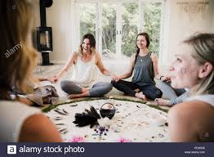
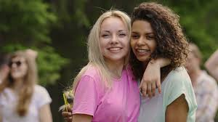

Slide 6
You have the potential to be a lighthouse – attracting like-minded people to you
We need to turn on the lighthouse beam so your people see you

Slide 7
How to beam bright
On point SEO copy to help the search engines, and your students/clients, find you
Fast website on both mobile and desktop
Professional presentation – good design, strong images

Slide 8
Seo research & copywriting

Slide 9
Driving organic traffic
You don’t currently have an organic strategy or SEO strategy
I can create a keyphrase strategy which will enable people to find you
This keyphrase strategy will be created for each page, so that each page has a commercial purpose

Slide 10
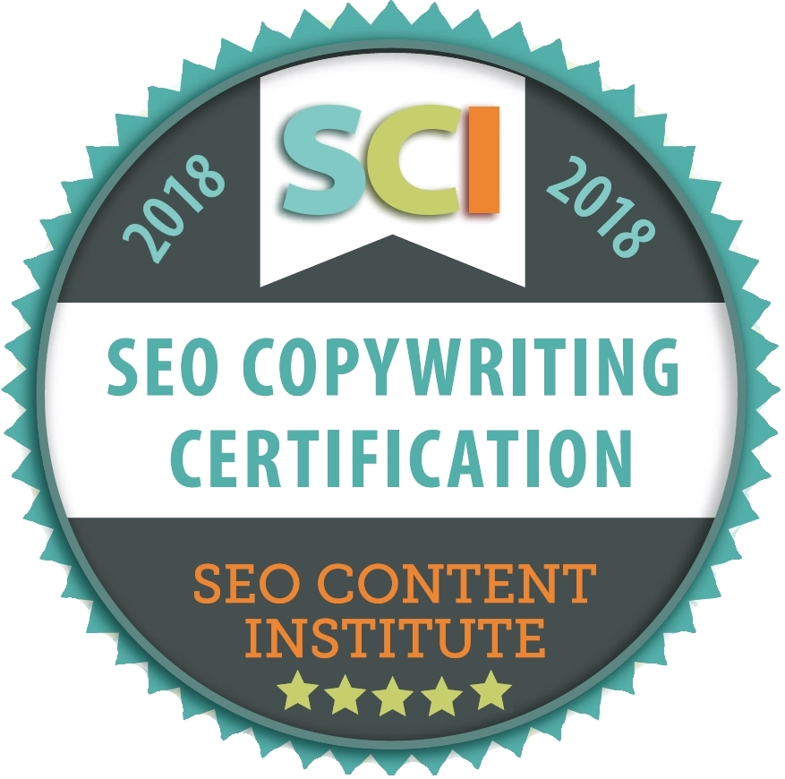
SEO Copywriting Certification
I am certified by The SEO Content Institute.
This certification is the only industry-endorsed training program that teaches writers SEO copywriting best practices.
It produces a select number of elite SEO copywriters every year - so I am v. chuffed to be able to say that I am one of them!
The Founder, Heather Lloyd-Martin, is a 20-year marketing veteran, a recognized author and considered the pioneer of SEO copywriting.

Slide 11
Example

Slide 12


Slide 13
5 Expertise pages
11 Services pages
About us x 4
Community pages
I wrote all the copy and conducted all the seo research https://bodypositiveworks.com/

Slide 14
As you know, I would also recommend creating some additional content
I recommend writing a number of posts targeting the services that you offer
(see module “Spreading the word)
I can create keyphrase strategies for these pages, driving traffic to the site
Creating this content is not included in the quote

Slide 15
Lucy’s copywriting testimonials

Slide 16
Testimonial jen kraft, yoga teacher & owner BoPo works
“Lucy had been recommended to us because she had extensive brand experience and experience both personally and professionally with the yoga world. In our first meeting with Lucy, she immediately and boldly told us that she felt that we should change our name. Our original name was The Body Image Boutique and she did not feel that the name properly reflected who we are. We engaged her immediately and were impressed every step of the way with her professionalism, creativity, and intelligence. She came up with alternative names for us to choose from and we decided on Body Positive Works with the tagline "The Feel Good Place." We love the name and the response from our community has been amazing. Lucy also developed a brand identity and copy strategy for us and also helped us develop our social media strategy. Working with Lucy from "across the pond" was never an issue and she was always available to us. I can't say enough about Lucy and look forward to working with her on future projects!”

Slide 17
David walker, group CEO, Happen Gp
“Lucy is absolutely top of her game. There's certainly more, but our experience of Lucy's work includes - great strategic planning, creative & on-point copywriting and deep expertise in the business of consumer marketing.”

Slide 18
Abbie Ferdinando, corporate comms, Grayling pr
“Lucy was a pleasure to work with – she ensured everything produced was on brief, on time, and written in a way that worked for the business.
But she also challenged and pushed us to be more creative and made suggestions for how we could use content across multiple channels.
Lucy has extensive knowledge about all aspects of copywriting as well as understanding what’s going to have the most impact from a marketing, PR and social media perspective.”

Slide 19
Time line
Process and dates

Slide 20
Time line
We agree your exact offering before we start – need to know your products/services
Week 1
I do the keyphrase research
Emailed to you for your comments/approval
Week 2
Onsite and SEO copy (meta titles and descriptions) emailed to you
Week 3
You review and feedback any revisions (one round)
I email you final copy

Slide 21
investment

Slide 22
SEO Strategy
SEO keyphrase research and keyword strategy x 3 pages (Homepage, Your Story, Services)
Key phrases
Meta descriptions
Meta titles
Total: £200
Excludes the cost of any article/blog post SEO

Slide 23
copywriting
Copywriting three pages
Homepage, Your Story & Services
Total: £425

Slide 24
Building your website

Slide 25
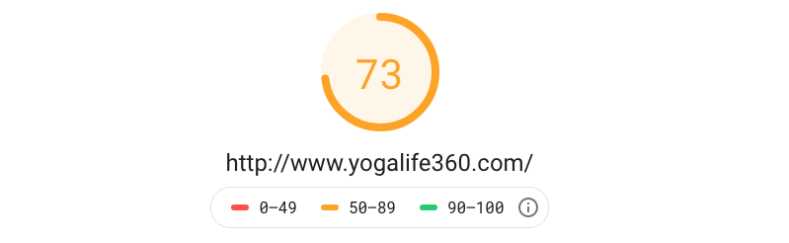

Building your website
Desktop
Your current site does not perform well
Looking at Google Page Insights we can see that it has amber warnings for both mobile and desktop
With a page load time of 4.6 seconds speed is of particular concern and a slow loading time can lead people to leave your site without viewing the content.
It also means you will be penalized by google –you will be ranked lower and may not be found in searches.
Mobile

Slide 26
Duncan can build you a best practice website
A brochure style website
Completely self-managed with a CMS system
All pages created
Super fast loading, latest technology under the hood
Angular Framework with Universal server side (Progressive web app)
Bootstrap 4
CSS3
HTML 5
HTTPS (W3c Standard)
With backward compatibility to previous browsers versions

Slide 27
menu structure options
Two options
Super simple – perhaps as the launch option
More functionality – when more established and have press, testimonials, etc.

Slide 28
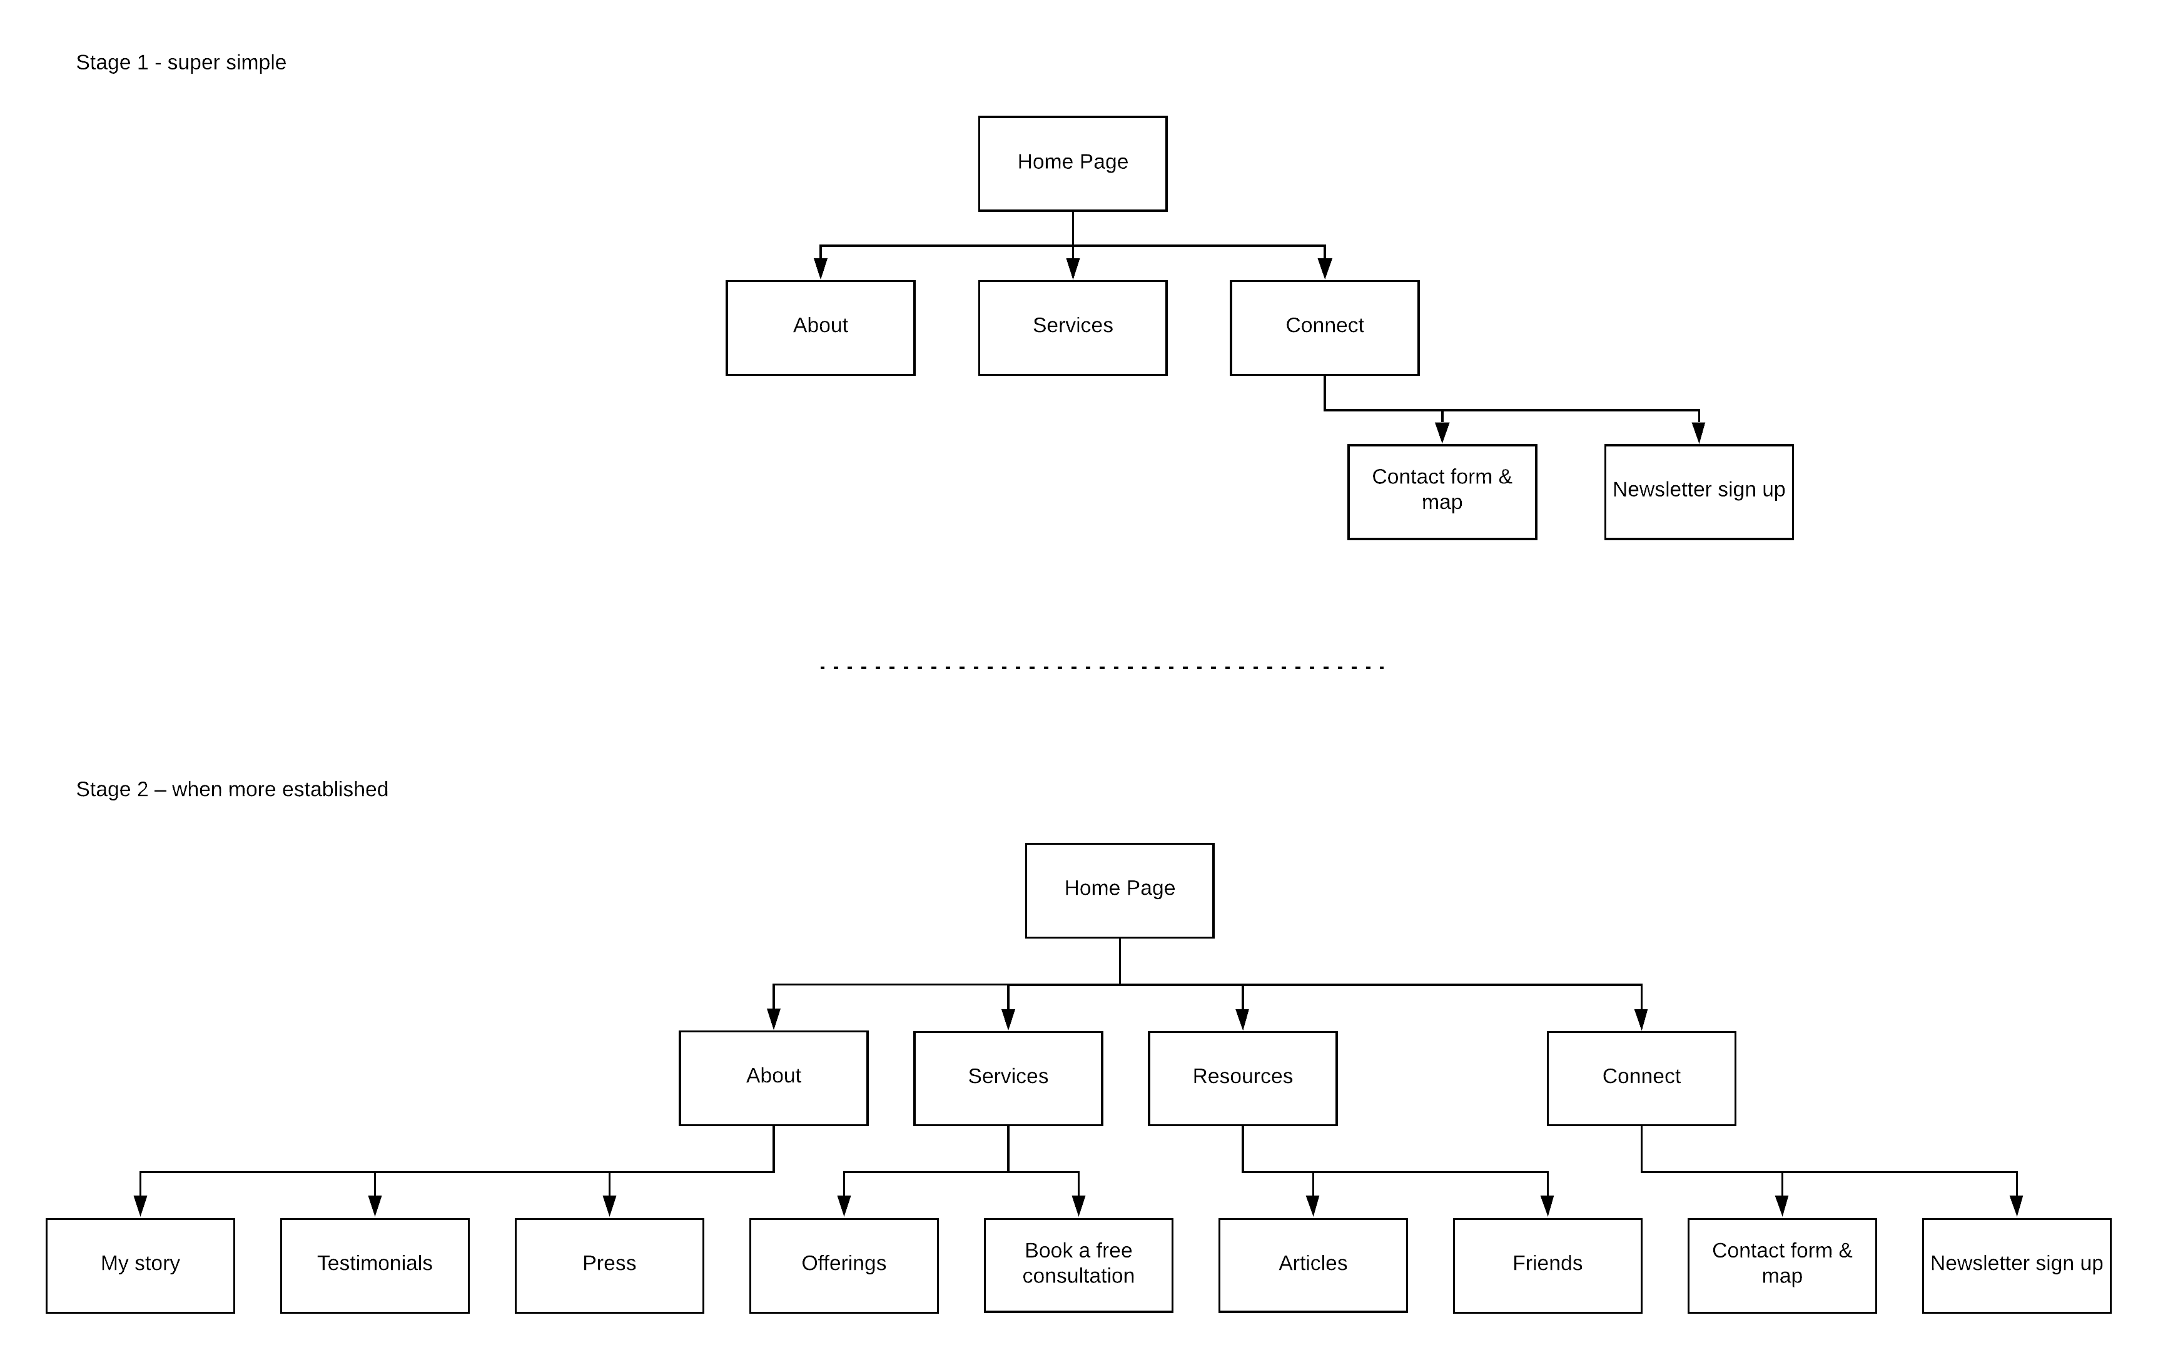

Slide 29
Web development
Stage 1
£1000 for the website build
An additional £400 if you want a content management system so you can update it yourself.
No monthly hosting costs, or ongoing SMS costs.
Stage 2
£1,900
If you decided to go straight to stage 2, without doing stage 1, the all-in development price would be £2,000
There would be additional costs from me if you want copy and SEO for these additional stage 2 pages (but not every page would need it – e.g. Testimonials, Press would not need it)

Slide 30
Web Development timings
Stage 1
2 to 3 weeks
Stage 2
1 to 2 months

Slide 31
Examples of duncan’s work

Slide 32
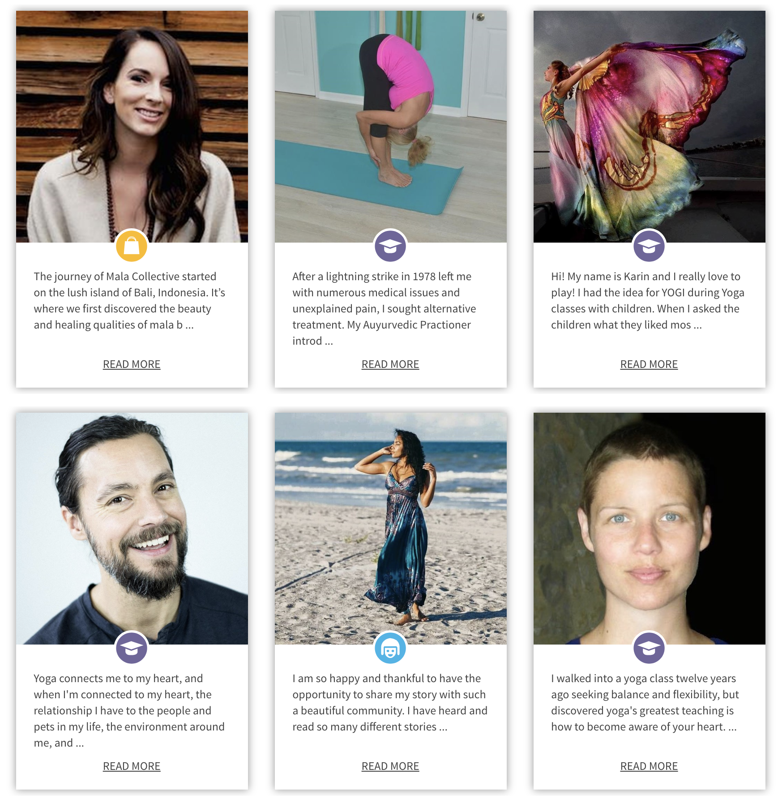
beginnersyogaguide.com

Slide 33
technologies
Bespoke website
C# MVC
Web API
Java, JSP
HTML 5
Servlets
C++
CSS3
JavaScript/jQuery
Matlab
OpenGL
XML
EJB
Asp
Asp.net
VB
SOAP
Microsoft SQL
MySQL
Perl and Angular

Slide 34

Yogaclicks.store

Slide 35
technologies
Shopify platform
App integration and management – including Ordoro, Zapier, Refersion and Sky Pilot
Highest performing yoga shop on Google Insights

Slide 36
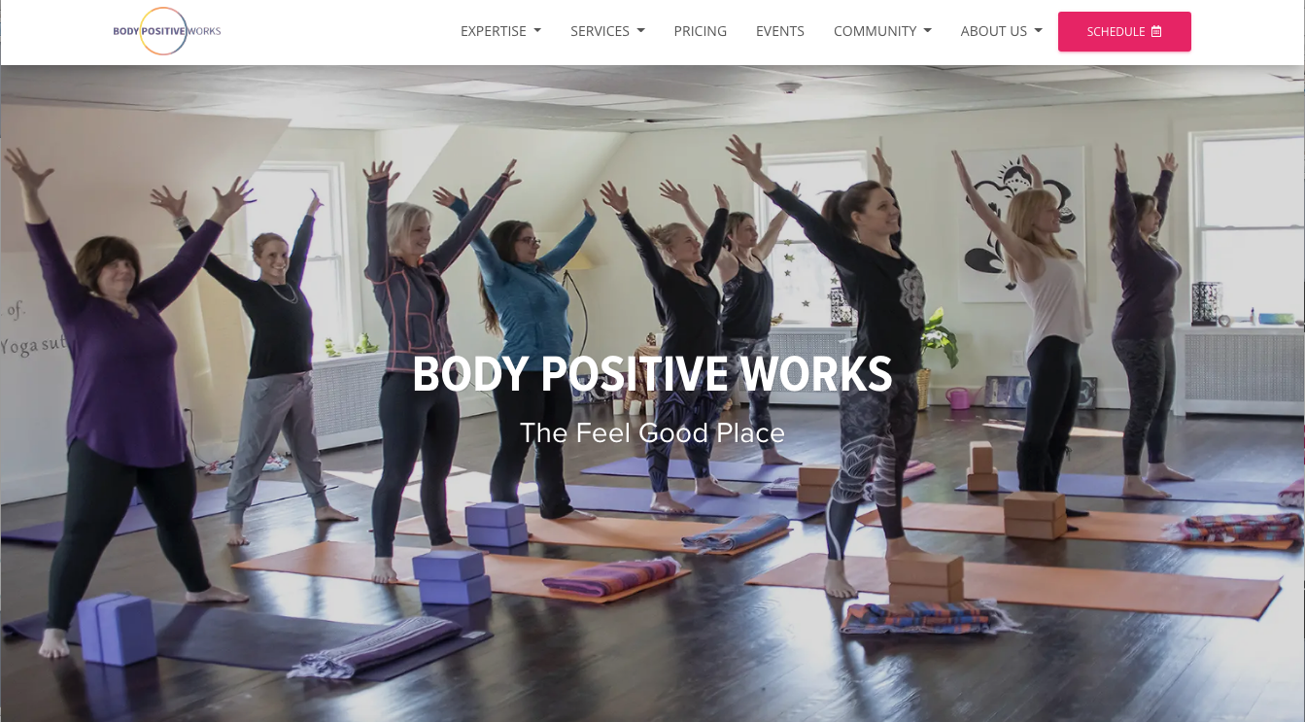
Body positive works

Slide 37
technologies
Angular 7
NGINX web hosting
CSS3 SASS
HTML5
WebP images with backward compatibility
Angular-universal with server side rendering
Service workers for offline servicing of the website (website works with no internet)
SEO Schema & Sitemaps
Bootstrap 4
Font Awesome icons

Slide 38
Duncan’s testimonials

Slide 39
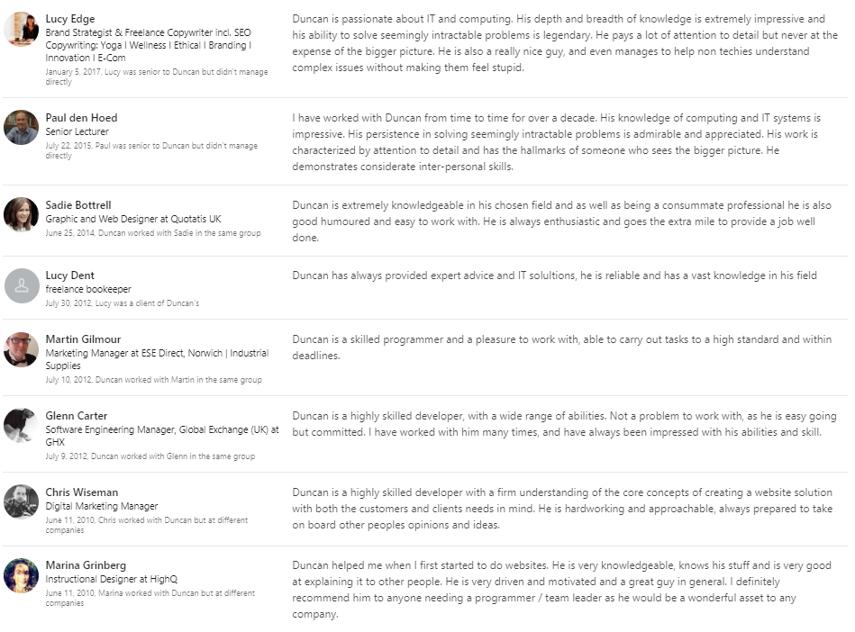

Slide 40
Terms & conditions

Slide 41
Terms and conditions
50% of each phase payable up front, within 7 days of invoice.
50% payable on completion of each phase, within 7 days of invoice.
Cancellation fees:
2 weeks before start of phase:
50% of the whole
1 week before start of phase:
75% of the whole

